Slide 1
Problems statement:
Issues faced by selenium synchronization, flakiness, inconsistency in test output.
Issues handling multiple framework for API, End to End, Visual, Accessibility, Performance testing.
by Anjuman Nadaf

Slide 2
Our Agenda:
Introduction to Cypress
Architecture of Cypress Vs Selenium
Installation, Test Runner, Locators, Dashboards
Cypress Vs Selenium
API testing using Cypress
Demo

Slide 3
Introduction to Cypress
What is Cypress? Cypress is a next generation frontend Automation testing tool built for the modern web application written in JavaScript.
Cypress is an open-source test automation tool that aims to provide a more straightforward and developer-friendly web application testing experience. It utilizes a DOM manipulation technique and directly interacts with browsers without the need for separate browser-specific drivers.
A basic understanding of JavaScript is enough to write test script in cypress. One may not need to be proficient in JS to work on Cypress

Slide 4
It delivers fast, consistent, and reliable test execution compared to other automation tools because of its architectural design.
Flake Resistant - Cypress automatically waits for commands and assertions before moving on. No more async issues.
Ability to test edge test cases by mocking the server response. (Network Requests)
Debuggability - It takes snapshots as your tests run. We can hover over each command in the Command Log to accurately see what happened at each step.
View videos of the execution of your entire tests when running from the Cypress Dashboard.

Slide 5
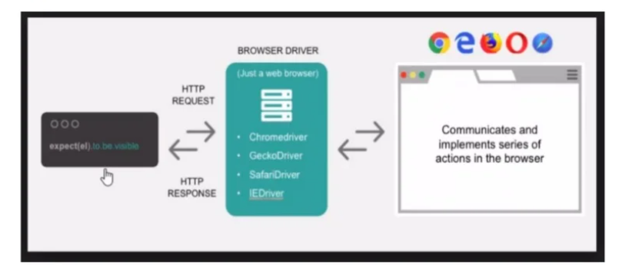
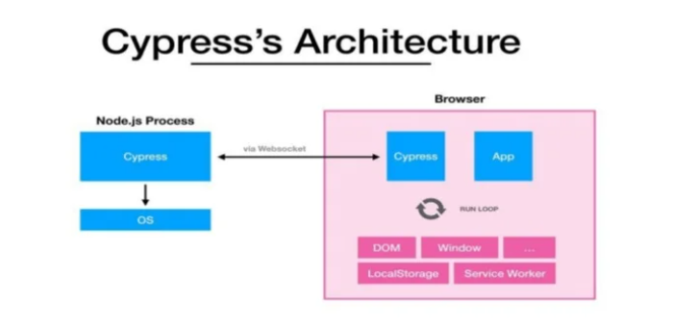
Selenium Vs Cypress architecture
Selenium operates by running outside of the browser and executing remote commands through network.
Cypress engine directly operates inside the browser no middleware.

Slide 6
Installation:
The prerequisite for installation in node.js. Since Cypress is JavaScript test automation tool, we would require node.js and npm(node package manager)
Steps for installation
npm i init, this will create a package.json file
npm install cypress –save -dev
this will fetch latest version of cypress that can be downloaded.
nodes_modules/.bin/cypress open,
we can use this command to open cypress runner.
Folder structure created
Fixtures: here we put all our test data files (json,text, excel etc)
e2e/Integration: all test script will be here
Support: Reusable methods or custom command can be put here.
To run test from terminal: node_modules/.bin/cypress run

Slide 7
Moving on, Cypress has two main components
Test Runner
Cypress Dashboard
Test Runner: Cypress runs tests in a unique interactive runner that allows you to see commands as they execute while also viewing the application under test.
Cypress Dashboard: It is an optional web-based companion to the test Runner. It provides timely, simple and powerful insights on all your tests run at a glance. Default Project (cypress.io)

Slide 8
Cypress Test Runner
Cypress runs tests in a unique interactive runner that allows you to see commands as they execute while also viewing the application under test.
This is where test are executed and it provides the following features:-
Test Status: Shows the summary of the test showcasing the number of passes and failed test cases.
Commands Logs: It shows all the logs that we get while interacting with the web element.
URL preview: shows the URL and helps to track the URL routes
App Preview: Shows real time interaction with web application.

Slide 9
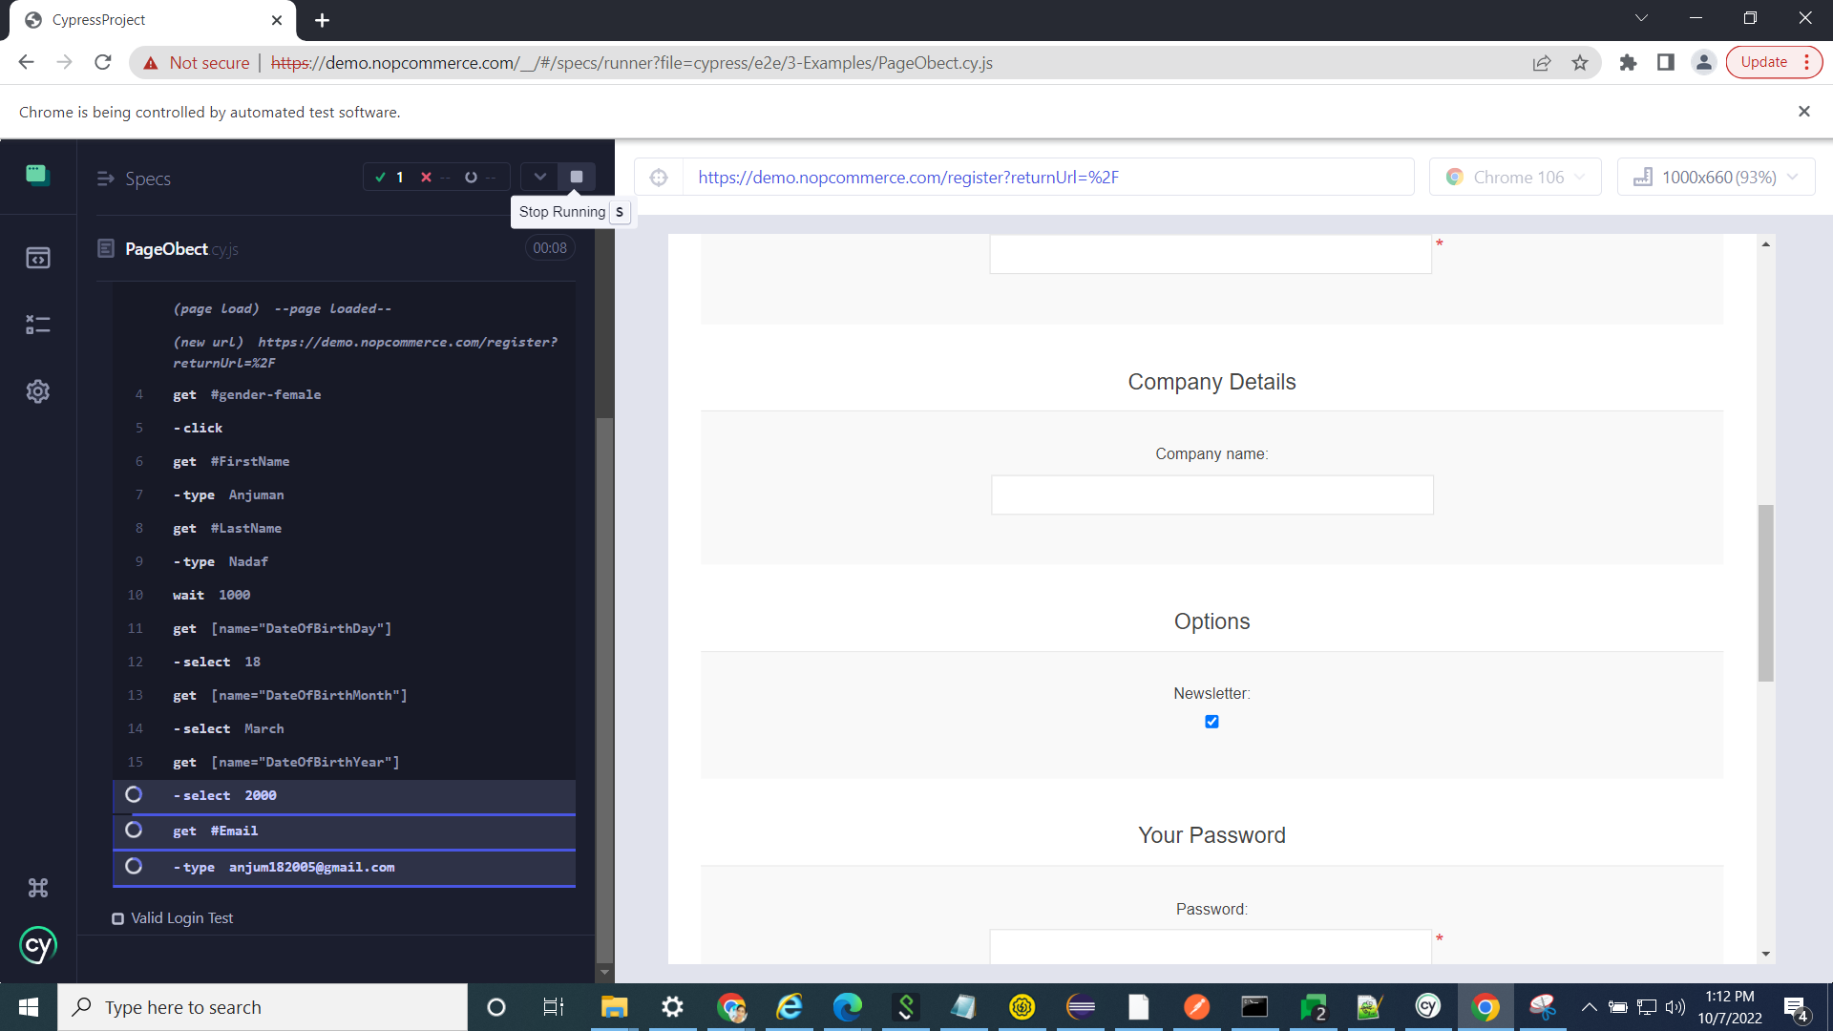

Slide 10
Writing a test in cypress
As we are writing our test in javaScript, we need to follow a standards of at least one javaScript test framework. Be it chai, Jasmine and Mocha.
To make test runnable, we need to inject out test into one of the testing framework it is same as in selenium, where we use TestNg.
It is recommended to mocha with Cypress
Mocha comes bundled with the Cypress library.
Here, describe keyword can be considered as a test suite and ‘it’ can be considered as test cases. Both of these keywords comes from mocha.
Cypress only supports CSS locators only.
However, with the help of an external plugin, cypress can also support Xpath locators as well, but doesn’t come by default.

Slide 11
Advantage Cypress over Selenium
It manipulates the browser to run the test execution
It takes screenshots automatically on failure, or record videos of your entire test suite when running from the CLI.
With Cypress, there is no need to put explicit waits or sleeps to your tests. It automatically waits for commands and assertions before proceeding.
It can take snapshots of the application when the tests are running. We can hover over each command in the Test Runner panel to see what happen at each steps.
Limitations
It is relatively new and does not have vast community that selenium does.
There is no support for multiple browser tabs.
Cypress only support JavaScript for creating test cases.

Slide 12
API testing using Cypress
Cypress is an emerging tool for E2E UI testing. There is also one major advantage that it provides API testing without installing any new library from npm package.
We can use Cypress for API testing directly after installing cypress main package.
Arguments:
url (String): The URL is used to make HTTP requests to server.
body (String, Object): A request body is used as a payload to our request. Cypress sets the ‘Accepts’ request header and serializes the response body by ‘encoding’ option.
Method: GET, PUT, POST ….

Slide 13
Demo
Simple testcase
Hooks in Cypress
POM in Cypress
Fixtures in Cypress (files supported .json,.html, .txt, . csv, .png, .jpg, .jpeg, .zip,. Tiff etc)
API testing
Dashboard
https://docs.cypress.io/guides/overview/why-cypress

Slide 14
Demo
Simple testcase
Hooks in Cypress
POM in Cypress
Fixtures in Cypress (files supported .json,.html, .txt, . csv, .png, .jpg, .jpeg, .zip,. Tiff etc)
API testing
Dashboard
https://docs.cypress.io/guides/overview/why-cypress

Slide 15
Q&A

